Slide 1
Studying local climate change
Maths and the environment

Slide 2
How our teaching resources are designed for the classroom

Slide 3
I can understand how the UK's weather has changed over a long time.

Slide 4
A forecast is a prediction of a future event occurring (based on data).
Extrapolation is the process of estimating unknown values that are outside the range of existing data.
Climate is the average weather pattern in an area across a long period of time.

Slide 5

Studying local climate change
Analysing local climate data
Forming conclusions about local climate change

Slide 6
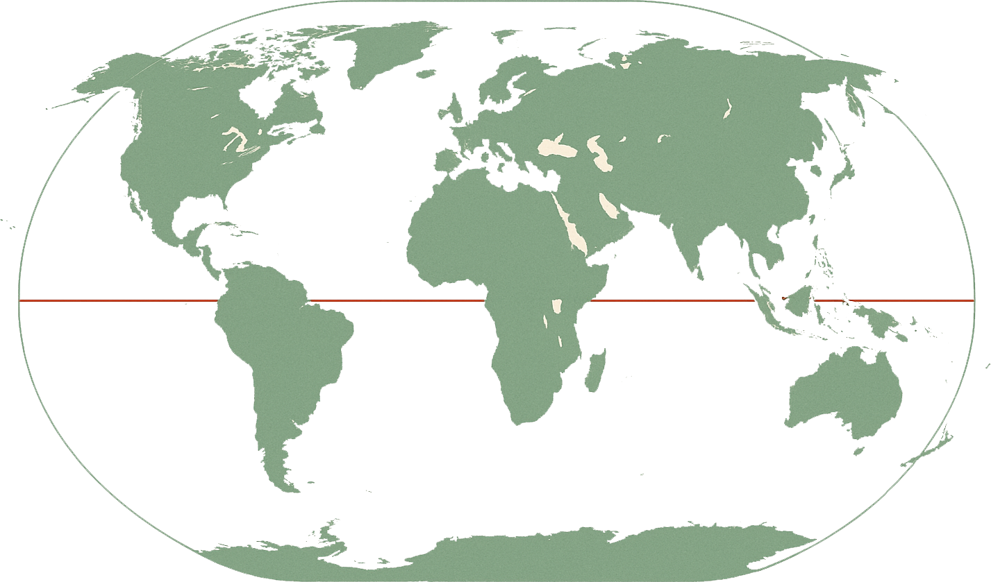


Analysing local climate data
How the climate of a country changes over time may differ depending on its location, due to factors such as:
its latitude
its proximity to a sea or ocean
carbon emissions
I wonder how the climate of the UK has changed over time!
It is highly unlikely that any two counties will have the exact same influence from these factors, therefore their climates will not evolve over time in the same way.
Andeep
Notes for video: simple definition of latitude: distance north or south of the equator.
First latitude shows how far north Cairo, Egypt is of the equator.
Second latitude shows how far north the UK is of the equator.

Slide 7
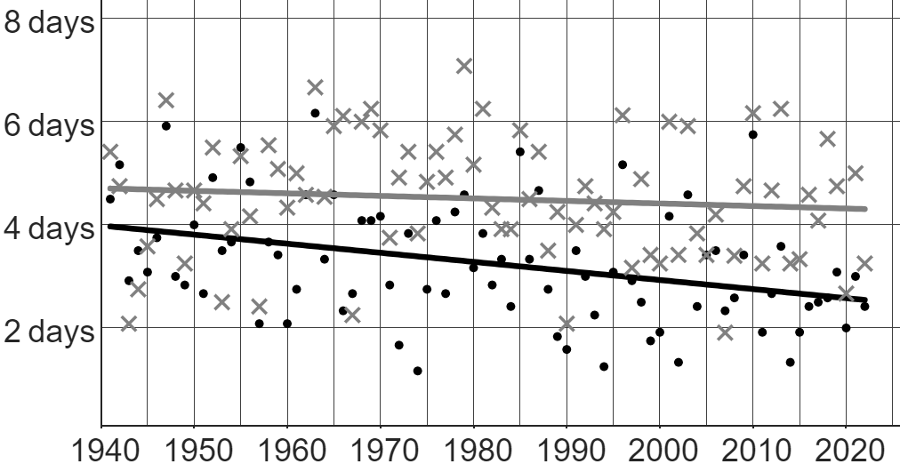
Analysing local climate data
We can compare how one part of the climate is changing over time in two different locations in the same country.
The graph shows data from the Met Office about the average number of days with air frost per month between the years 1941 and 2022 in Nairn and Oxford.
graph showing air frost over time
Key
Nairn (Scotland)
Oxford (South England)

Slide 8
Analysing local climate data
We can compare how one part of the climate is changing over time in two different locations in the same country.
These two data points show the average number of days of air frost per month in 1947 in both Nairn and Oxford.
For Nairn, the average was just over 6 days, whilst in Oxford it was just under 6 days.
graph showing air frost over time
Key
Nairn (Scotland)
Oxford (South England)

Slide 9
Analysing local climate data
We can compare how one part of the climate is changing over time in two different locations in the same country.
We can look at the trendlines in both locations to help us understand the long-term patterns and changes to this part of the climate.
graph showing air frost over time
Key
Nairn (Scotland)
Oxford (South England)

Slide 10
Analysing local climate data
We can compare how one part of the climate is changing over time in two different locations in the same country.
The trendline for Nairn is higher than Oxford.
Therefore, the general pattern is that we expect to see more days per month of air frost in Nairn than Oxford.
Whilst this trend is usually true, there may be some years that break the trend.
graph showing air frost over time
Key
Nairn (Scotland)
Oxford (South England)
For example, in 1955 when Oxford had a slightly higher average than Nairn.

Slide 11
Analysing local climate data
We can compare how one part of the climate is changing over time in two different locations in the same country.
The gradient of the trendline shows how quickly a change is happening.
The trendline for Nairn has a very shallow, negative gradient.
This means the long-term trend for the average number of days of air frost per month is:
decreasing… but not by much.
graph showing air frost over time
Key
Nairn (Scotland)
Oxford (South England)

Slide 12
Analysing local climate data
We can compare how one part of the climate is changing over time in two different locations in the same country.
The trendline for Oxford also has negative gradient.
However, this gradient is steeper, meaning that the average number of days of air frost per month in Oxford is decreasing at a faster rate than in Nairn.
graph showing air frost over time
Key
Nairn (Scotland)
Oxford (South England)

Slide 13
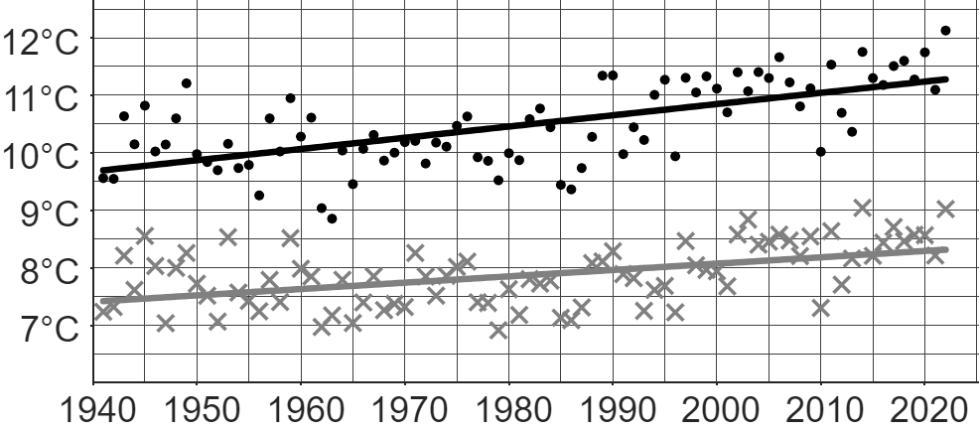


Analysing local climate data
The graph shows data from the Met Office about the average annual temperature from 1941 to 2022 in Wick and Oxford.
Key
Wick
Oxford
Which of these statements is correct?
a
The average temperature in Wick in 2022 was higher than the average temperature in any other year.
b
The average temperature in Oxford in 2022 was higher than the average temperature in any other year.

Slide 14
Analysing local climate data
The graph shows data from the Met Office about the average annual temperature from 1941 to 2022 in Wick and Oxford.
Key
Wick
Oxford
Which of these statements is correct?
a
In Oxford, every day in 2022 was hotter than every day in 1990.
Just because the average temperature in 2022 (in Oxford) was higher than the average temperature in 1990 does not mean that every single day in 2022 had a temperature higher than the hottest day in 1990.
For example, a winter’s day in 2022 was still likely much colder than a summer’s day in 1990.
b
In Oxford, the general (or long-term) trend is that temperatures are increasing.

Slide 15
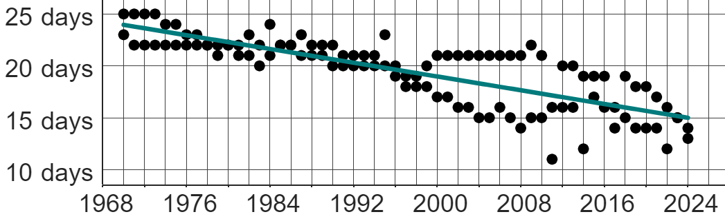
Analysing local climate data
This graph shows the number of days of air frost in Oakfield each month of January and February from 1970 to 2024.
Which of these statements are correct about the air frost in Oakfield?
a
Each year, the number of days of air frost each month decreases.
b
A long-term trend is that the number of days of air frost each month is decreasing.
c
A long-term trend is that there is now a greater variety in the number of days of air frost each month compared to in the past.

Slide 16

Analysing local climate data
This graph shows the number of days of air frost in Oakfield each month of January and February from 1970 to 2024.
Gosh, the number of days of air frost each month in 2024 is close to zero!
Explain why Aisha’s conclusion is incorrect.
The y-axis of this graph starts at 10 days, not 0 days.
Whilst the trend is that the number of days of air frost each month is decreasing, months in 2024 still have 13 and 14 days of air frost.
Aisha

Slide 17
Analysing local climate data
This graph shows the number of days of air frost in Oakfield each month of January and February from 1970 to 2024.
Which conclusions may be sensible from this data alone?
a
The average temperature in Oakfield in January and February may be increasing over time.
b
The number of days of air frost each January and February may be decreasing across the whole of the UK.
Neither conclusion can be made with confidence.
It is tricky to make broad conclusions from a limited data set.
We do not know anything about other factors, so we cannot assume that an increase in temperature is the cause of the decline in air frost.
And just because a trend is occurring in one part of the UK doesn’t mean that the same trend is occurring across the whole of the UK.

Slide 18
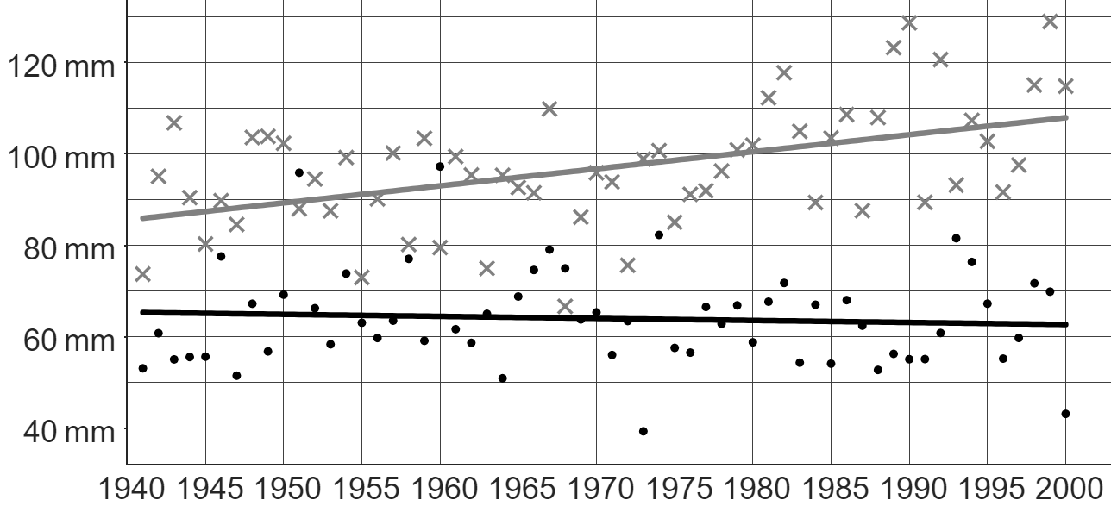
Analysing local climate data
This graph from the Met Office shows the average monthly rainfall (in mm) each year from 1941 to 2000 in Stornoway and Southampton.
Key
Stornoway
Southampton
Andeep says: “We usually expect to see more rain falling each month in Stornoway than in Southampton.”
1a) Explain how Andeep might have come to this conclusion.
b) In 1968, more rain fell in Southampton than in Stornoway. Explain whether this makes Andeep’s claim incorrect or not.

Slide 19
Analysing local climate data
This graph from the Met Office shows the average monthly rainfall (in mm) each year from 1941 to 2000 in Stornoway and Southampton.
Key
Stornoway
Southampton
Sofia says: “Over time, the general trend in Stornoway is that the average amount of rainfall is increasing.”
c) Sofia is correct. Explain how Sofia might have come to this conclusion.
d) Write a sentence describing the long-term trend of Southampton’s rainfall.

Slide 20
Analysing local climate data
This graph from the Met Office shows the average monthly rainfall (in mm) each year from 1941 to 2000 in Stornoway and Southampton.
Key
Stornoway
Southampton
Izzy says: “Stornoway is in Scotland. That means the amount of rainfall in other parts of Scotland is also increasing over time.”
e) Explain whether Izzy’s statement is correct or not.

Slide 21
Analysing local climate data
This graph from the Met Office shows the average monthly rainfall (in mm) each year from 1941 to 2000 in Stornoway and Southampton.
Key
Stornoway
Southampton
Andeep says: “We usually expect to see more rain falling each month in Stornoway than in Southampton.”
1a) Explain how Andeep might have come to this conclusion.
The trendline for Stornoway is above the trendline for Southampton.
This means there is a trend of Stornoway having a larger amount of rainfall than Southampton.

Slide 22
Analysing local climate data
This graph from the Met Office shows the average monthly rainfall (in mm) each year from 1941 to 2000 in Stornoway and Southampton.
Key
Stornoway
Southampton
b) In 1968, more rain fell in Southampton than in Stornoway. Explain whether this makes Andeep’s claim incorrect or not.
Andeep is correct. The trend is definitely that Stornoway has more rainfall than Southampton. A few years that do not fit this trend does not mean the trend isn’t true across a longer timeframe.

Slide 23
Analysing local climate data
This graph from the Met Office shows the average monthly rainfall (in mm) each year from 1941 to 2000 in Stornoway and Southampton.
Key
Stornoway
Southampton
Sofia says: “Over time, the general trend in Stornoway is that the average amount of rainfall is increasing.”
c) Sofia is correct. Explain how Sofia might have come to this conclusion.
Stornoway’s trendline has a positive gradient (the line is going up from left to right).

Slide 24
Analysing local climate data
This graph from the Met Office shows the average monthly rainfall (in mm) each year from 1941 to 2000 in Stornoway and Southampton.
Key
Stornoway
Southampton
d) Write a sentence describing the long-term trend of Southampton’s rainfall.
Over time, the general trend in Southampton is that the average amount of rainfall is very slightly decreasing.
or The average amount of rainfall is staying fairly constant over time.

Slide 25
Analysing local climate data
This graph from the Met Office shows the average monthly rainfall (in mm) each year from 1941 to 2000 in Stornoway and Southampton.
Key
Stornoway
Southampton
Izzy says: “Stornoway is in Scotland. That means the amount of rainfall in other parts of Scotland is also increasing over time.”
e) Explain whether Izzy’s statement is correct or not.
It is not sensible to generalise conclusions about one location to other locations, even within the same country.
There are several reasons for this, such as Stornoway’s proximity to the sea, compared to other parts of Scotland.

Slide 26
Studying local climate change
Analysing local climate data
Forming conclusions about local climate change

Slide 27
Forming conclusions about local climate change
It is possible to combine different sets of climate data about a location to identify correlations involving time.

Slide 28
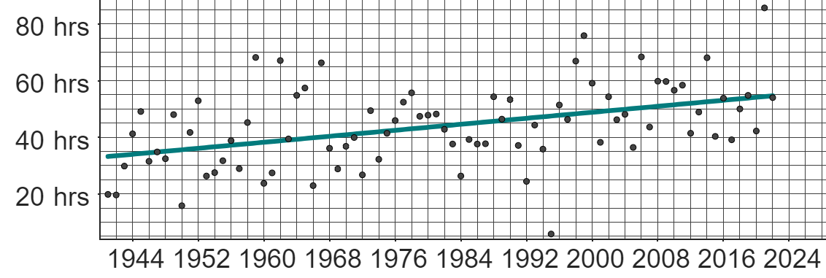
Forming conclusions about local climate change
This graph shows data from the Met Office on the total monthly sunshine hours in January each year from 1941 to 2022 in Sheffield.
The long-term trend of this data suggests that the total number of sunshine hours in Sheffield each January has increased over time.

Slide 29
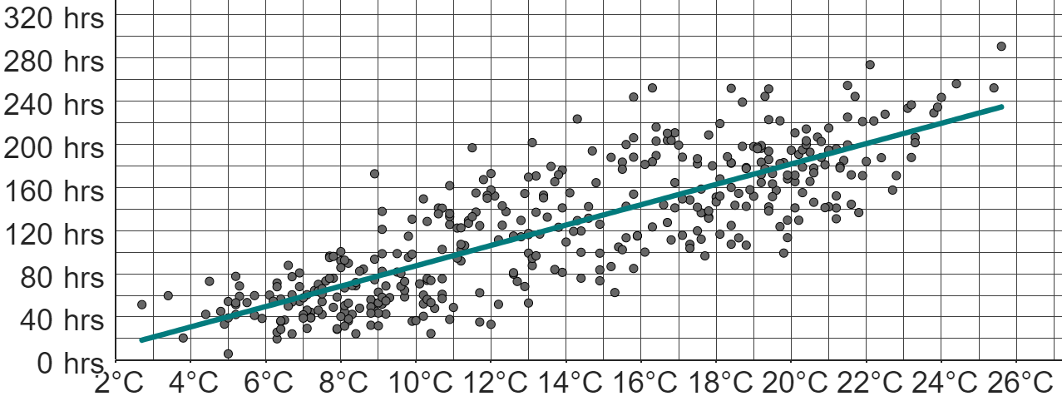
Forming conclusions about local climate change
This graph shows data from the Met Office on the total monthly sunshine hours in January each year from 1941 to 2022 in Sheffield.
The second graph shows data from the Met Office on the mean daily maximum temperature and the total monthly sunshine hours for every month from 1990 to 2022 in Sheffield.

Slide 30
Forming conclusions about local climate change
There is a positive correlation between the mean daily maximum temperature and the total monthly sunshine hours.
The trend of this data suggests that the greater the maximum temperature, the greater the total monthly sunshine hours.
The second graph shows data from the Met Office on the mean daily maximum temperature and the total monthly sunshine hours for every month from 1990 to 2022 in Sheffield.

Slide 31
Forming conclusions about local climate change
Both graphs show positive correlation.
Furthermore, both graphs share the common variable of “total monthly sunshine hours”.
It may be possible to identify a correlation between the non-common variable in each graph.

Slide 32
Forming conclusions about local climate change
Graph 1 shows that the total monthly sunshine hours increases over time.
Graph 2 shows that the total monthly sunshine hours increases as the maximum temperature increases.
Therefore, the maximum temperature may also increase over time.

Slide 33
Forming conclusions about local climate change
From these two graphs, we have identified a possible positive correlation between time and mean daily maximum temperature in Sheffield.
Conclusions made from comparing multiple sets of data may be more accurate than from just one set of data.

Slide 34
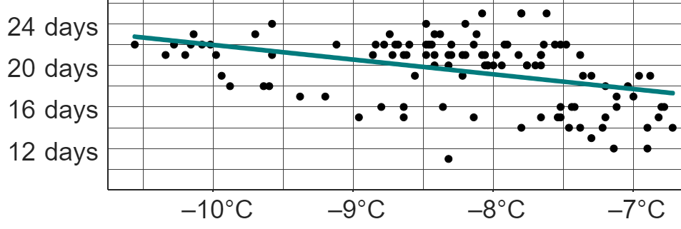
Forming conclusions about local climate change
number of days of air frost each month
Both graphs show data in Oakfield for the months of January and February from 1970 to 2024.
What is the common variable across both graphs?
number of days of air frost
mean daily minimum temperature vs. number of days of air frost

Slide 35
Forming conclusions about local climate change
number of days of air frost each month
Both graphs show data in Oakfield for the months of January and February from 1970 to 2024.
Describe the correlation between the mean daily minimum temperature and the number of days of air frost.
As the temperature increases, the number of days of air frost decreases.
negative correlation
mean daily minimum temperature vs. number of days of air frost

Slide 36
Forming conclusions about local climate change
number of days of air frost each month
Complete this possible conclusion using both graphs:
Because the long-term trend is that the number of days of air frost per month is decreasing over time, the mean daily minimum temperature is _____________ over time.
increasing
mean daily minimum temperature vs. number of days of air frost

Slide 37
Forming conclusions about local climate change
This graph shows data from the Met Office on the total monthly sunshine hours in January each year from 1941 to 2022 in Sheffield.
The second graph shows data from the Met Office on the mean daily maximum temperature and the total monthly sunshine hours for every month from 1990 to 2022 in Sheffield.
However, the extent to which a conclusion is accurate may depend on the validity of the comparisons made between the two graphs.

Slide 38
Forming conclusions about local climate change
This graph shows data from the Met Office on the total monthly sunshine hours in January each year from 1941 to 2022 in Sheffield.
The second graph shows data from the Met Office on the mean daily maximum temperature and the total monthly sunshine hours for every month from 1990 to 2022 in Sheffield.
One graph shows data from only the January of each year, whilst the other shows data from every month of each year.
The timeframes across both graphs are also different, with the long-term trends from the first graph accounting for more years of data than the second.

Slide 39
Forming conclusions about local climate change
This graph shows data from the Met Office on the total monthly sunshine hours in January each year from 1941 to 2022 in Sheffield.
The second graph shows data from the Met Office on the mean daily maximum temperature and the total monthly sunshine hours for every month from 1990 to 2022 in Sheffield.
The conclusion of “the maximum temperature may also increase over time” may not be accurate, as only a small proportion of the data from each group has been taken from the same periods of time.

Slide 40
Forming conclusions about local climate change
number of days of air frost each month
Both graphs show data in Oakfield for the months of January and February from 1970 to 2024.
Give one reason why conclusions from comparing these two graphs may be accurate.
Both graphs show data from the same location and in the same time period (January & February 1970 to 2024).
mean daily minimum temperature vs. number of days of air frost

Slide 41
Forming conclusions about local climate change
 | distance (d), in km
 | d < 2 | 2 ≤ d < 5 | 5 ≤ d < 10 | 10 ≤ d < 20 | 20 ≤ d < 30 | 30 ≤ d < 40 | 40 ≤ d < 60 | d ≥ 60
North East | 202 172 | 235 849 | 220 617 | 192 451 | 55 976 | 20 205 | 15 795 | 33 880
South East | 706 167 | 688 146 | 604 950 | 582 465 | 301 705 | 156 951 | 168 384 | 169 351
1) This table from the ONS shows the distance people in the North-East and South-East of England travelled to work each day in 2011.
a) How many people’s information from the North-East were collected for this survey?
b) What fraction of people in the South-East travel under 10 km each day to work?
One possible influence on the climate of an area is the amount of carbon emissions (linked with travelling longer distances).
c) In which location (North-East or South-East) does a higher percentage of people travel 20 km or further each day to work?

Slide 42
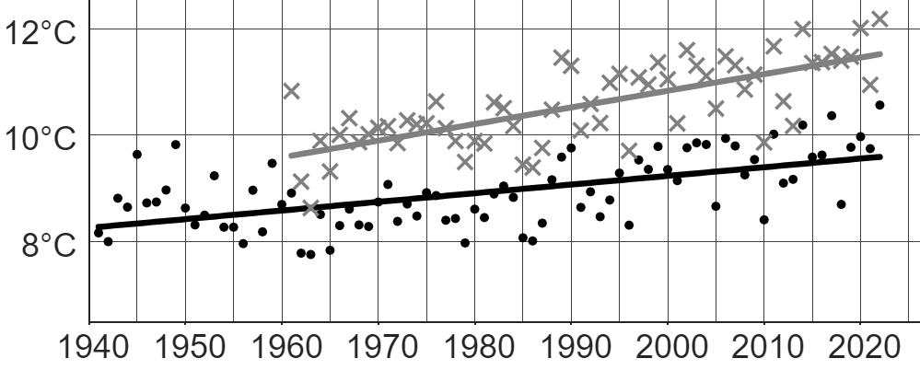
Forming conclusions about local climate change
This graph shows data from the Met Office on the mean yearly temperature for two UK locations: Manston (1961 – 2022) and Durham (1941 – 2022).
Key
Manston (South-East England)
Durham (North-East England)
2) The long-term trends of both Manston and Durham are similar. Both locations show an increase in mean yearly temperature over time.
In which location is the mean yearly temperature increasing at the faster rate? Explain how you know.

Slide 43
Forming conclusions about local climate change
This graph shows data from the Met Office on the mean yearly temperature for two UK locations: Manston (1961 – 2022) and Durham (1941 – 2022).
Key
Manston (South-East England)
Durham (North-East England)
3a) Using both your answers to question 1c and 2, write down a possible link between distance travelled to work and mean yearly temperature.
b) Explain the extent to which this link is accurate or not by assessing the validity of the comparisons across both sets of data.

Slide 44
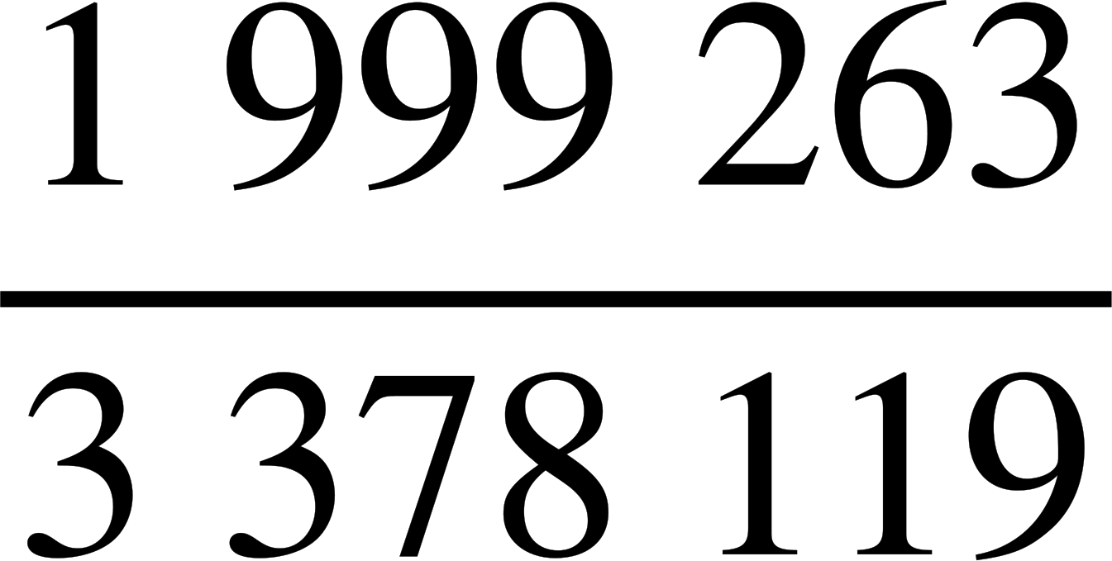
Forming conclusions about local climate change
 | distance (d), in km
 | d < 2 | 2 ≤ d < 5 | 5 ≤ d < 10 | 10 ≤ d < 20 | 20 ≤ d < 30 | 30 ≤ d < 40 | 40 ≤ d < 60 | d ≥ 60
North East | 202 172 | 235 849 | 220 617 | 192 451 | 55 976 | 20 205 | 15 795 | 33 880
South East | 706 167 | 688 146 | 604 950 | 582 465 | 301 705 | 156 951 | 168 384 | 169 351
1) This table from the ONS shows the distance people in the North-East and South-East of England travelled to work each day in 2011.
a) How many people’s information from the North-East were collected for this survey?
b) What fraction of people in the South-East travel under 10 km each day to work?
976 945 people

Slide 45
Forming conclusions about local climate change
 | distance (d), in km
 | d < 2 | 2 ≤ d < 5 | 5 ≤ d < 10 | 10 ≤ d < 20 | 20 ≤ d < 30 | 30 ≤ d < 40 | 40 ≤ d < 60 | d ≥ 60
North East | 202 172 | 235 849 | 220 617 | 192 451 | 55 976 | 20 205 | 15 795 | 33 880
South East | 706 167 | 688 146 | 604 950 | 582 465 | 301 705 | 156 951 | 168 384 | 169 351
1) This table from the ONS shows the distance people in the North-East and South-East of England travelled to work each day in 2011.
One possible influence on the climate of an area is the amount of carbon emissions (linked with travelling longer distances).
c) In which location (North-East or South-East) does a higher percentage of people travel 20 km or further each day to work?
North-East: 12.9% (1 d.p.)
South-East: 23.6% (1 d.p.)
A larger percentage of people in the South-East travel 20 km or further.

Slide 46
Forming conclusions about local climate change
This graph shows data from the Met Office on the mean yearly temperature for two UK locations: Manston (1961 – 2022) and Durham (1941 – 2022).
Key
Manston (South-East England)
Durham (North-East England)
2) The long-term trends of both Manston and Durham are similar. Both locations show an increase in mean yearly temperature over time.
In which location is the mean yearly temperature increasing at the faster rate? Explain how you know.
Manston’s mean yearly temperature is increasing at a faster rate than Durham’s because Manston’s long-term trendline has a steeper gradient.

Slide 47
Forming conclusions about local climate change
This graph shows data from the Met Office on the mean yearly temperature for two UK locations: Manston (1961 – 2022) and Durham (1941 – 2022).
Key
Manston (South-East England)
Durham (North-East England)
2) The long-term trends of both Manston and Durham are similar. Both locations show an increase in mean yearly temperature over time.
In which location is the mean yearly temperature increasing at the faster rate? Explain how you know.
Note: Temperature increasing at a faster rate is due to the steepness of Manston’s trendline, not because the line itself is higher up than Durham’s.

Slide 48
Forming conclusions about local climate change
This graph shows data from the Met Office on the mean yearly temperature for two UK locations: Manston (1961 – 2022) and Durham (1941 – 2022).
Key
Manston (South-East England)
Durham (North-East England)
3a) Using both your answers to question 1c and 2, write down a possible link between distance travelled to work and mean yearly temperature.
The link could be that locations where people travel longer distances to get to work (and the resultant higher carbon emissions) have temperatures that increase at a faster rate than locations where fewer people travel longer distances to get to work.

Slide 49
Forming conclusions about local climate change
This graph shows data from the Met Office on the mean yearly temperature for two UK locations: Manston (1961 – 2022) and Durham (1941 – 2022).
Key
Manston (South-East England)
Durham (North-East England)
b) Explain the extent to which this link is accurate or not by assessing the validity of the comparisons across both sets of data.
Whilst both the table (question 1) and graph (question 2) show data from the South-East and North-East regions of England, the graph only shows data from one part of each region.
Therefore, it may not be valid to generalise the conclusions we make about the rate of temperature increase from Manston and Durham to the rest of each region.

Slide 50
Forming conclusions about local climate change
This graph shows data from the Met Office on the mean yearly temperature for two UK locations: Manston (1961 – 2022) and Durham (1941 – 2022).
Key
Manston (South-East England)
Durham (North-East England)
b) Explain the extent to which this link is accurate or not by assessing the validity of the comparisons across both sets of data.
Positives that give validity to our comparisons include the timeframes. Both regions in the graph show data from 1961 to 2022 (with Durham having data going back to 1941), which allow for like comparisons between regions. Furthermore, the table from question 1 shows data collected in 2011, which is within the 1961 to 2022 timeframe.

Slide 51
Studying local climate change
There are many elements to a climate, such as temperature, amount of rainfall, amount of air frost, etc.
A measurable element of the climate across multiple locations can be compared on a graph. It is possible to establish and compare long term trends between these locations.
However, these trends cannot be generalised to other locations or other elements of the climate without further information.
It is possible to begin forming conclusions about the climate of a location by considering data from multiple different elements of its climate and analysing any links between each dataset.
However, the extent to which these conclusions may be helpful depends on whether each dataset shows trends from the same location over the same period of time.

Slide 52

© Oak National Academy 2024.
Produced in partnership with Mathematics in Education and Industry.
Licensed on the Open Government Licence v3.0, except where otherwise stated. See Oak terms and conditions.

